Slide 1
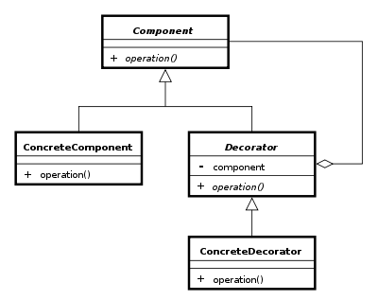
The Decorator pattern
Group 4
Asger B. Breinholm, Mathias Brandgaard and Rob Bertojo

Slide 2
The problem
Too many new classes

Slide 3
The solution – with Decorator

Slide 4
Pros & cons
Pros:
Cons:

Slide 5
Class diagram

Slide 6
Sequence diagram

Slide 7
Our implementation

Slide 8
Comparison

Slide 9
Conclusion

